Slide 1
MowBotic
The next generation of lawnmowing
By Xiang Chen, Miguel, Reddy, Raja, Jacob Liese, Jason Gang, Ahad Rajput, Danny Wagner, and Domonique Duliepre

Slide 2

Motivation
There are about 70 million households in the US living in the suburban area. They need to mow their lawns biweekly, weekly or monthly. The average lawn mowing time is 1-2 hours or the cost is $20-$50 if you are hiring someone to do it for you. By automating this task, it allows individuals to better spend their time and allow the automated lawn mower to take over this mundane task.

Slide 3
Inspiration
The inspiration for this project came from wanting to innovate on the idea of a Roomba, by applying its technology to a different application. It is to create an autonomous lawn mower that meets the needs of modern standards. The design will focus on minimizing the time and money spent on lawn mowing.

Slide 4
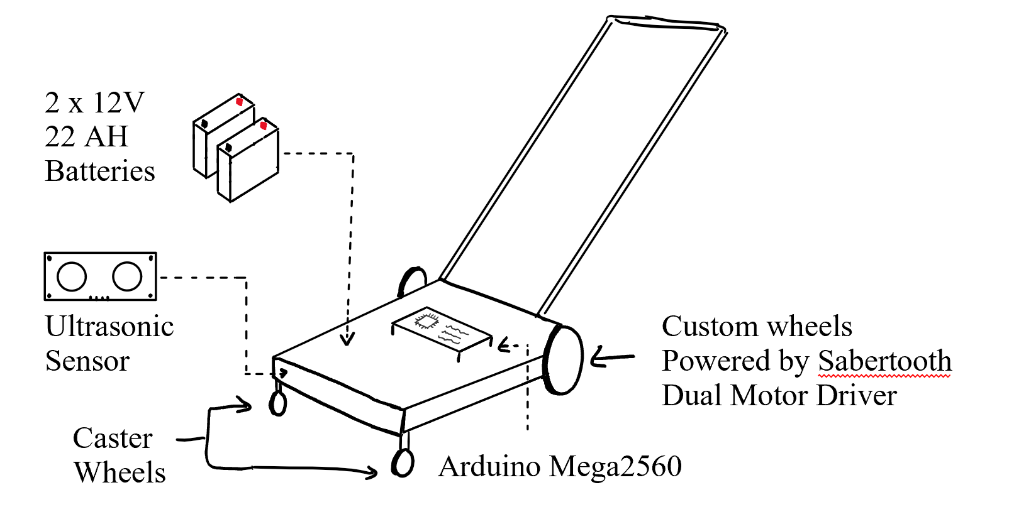
Build Design

Slide 5
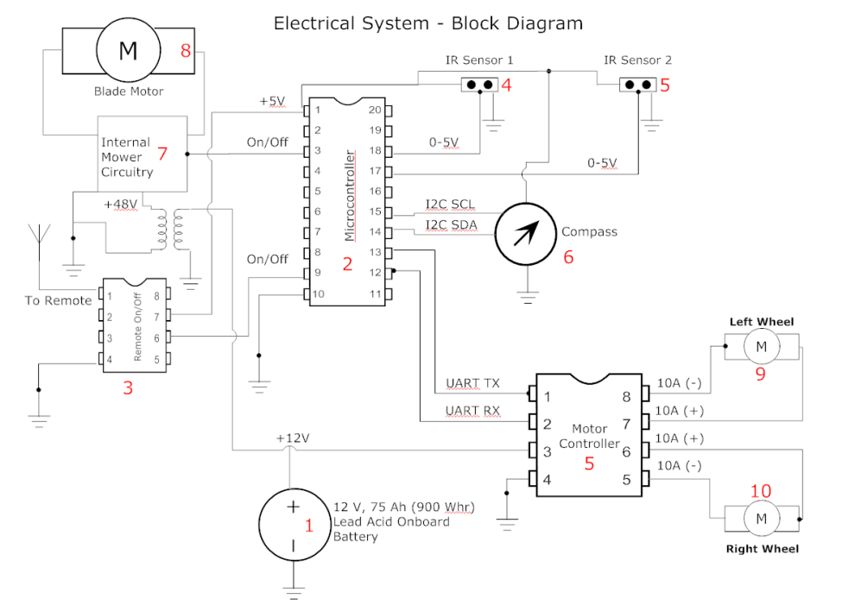
Electrical System-Block Diagram
24 V 22Ah Batteries

Slide 6
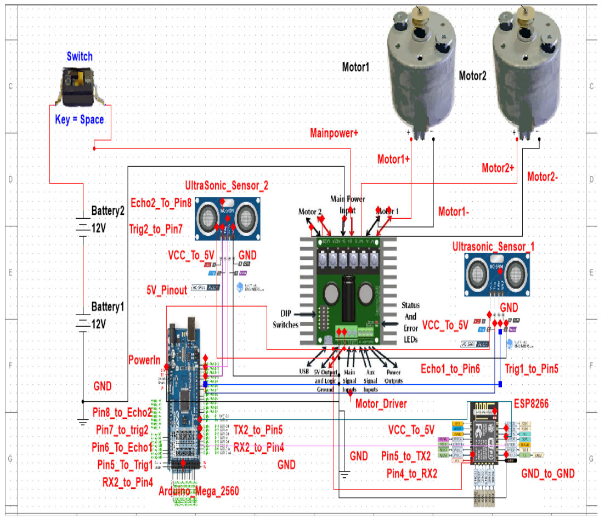
Main Circuit Diagram

Slide 7
Power Calculation
Power Consumption
Arduino Mega: 2.5 Wh
Arduino Nano: 0.0627 Wh
Ultrasonic Sensor x3: 0.075 Wh
ACS758 Sensor Module: 0.1 Wh
Motors (x2): 72-960 Wh
Sabertooth Motor-driver: 768 Wh
Power Supply
Mighty Max Battery: 1056 Wh
Max Run Time : 36 Minutes

Slide 8
Components List
Jazzy Electric Drive Motors/Wheelchair Motor 12-24 VDC
Arduino Mega 2560 with Built-in ESP8266 WIFI
Sun Joe MJ401C Cordless Lawn Mower
Sabretooth Dual 32A Motor Driver
Digital Compass IC HMC5883L
T Slotted Aluminum Extrusion
Ultrasonic HC-SR04 Sensor
PVC Swivel Caster Wheels
Magnetic Contact Switch
Neo-6M GPS Module
Primo Drive Wheels
Mighty Max Battery
Power Supply

Slide 9
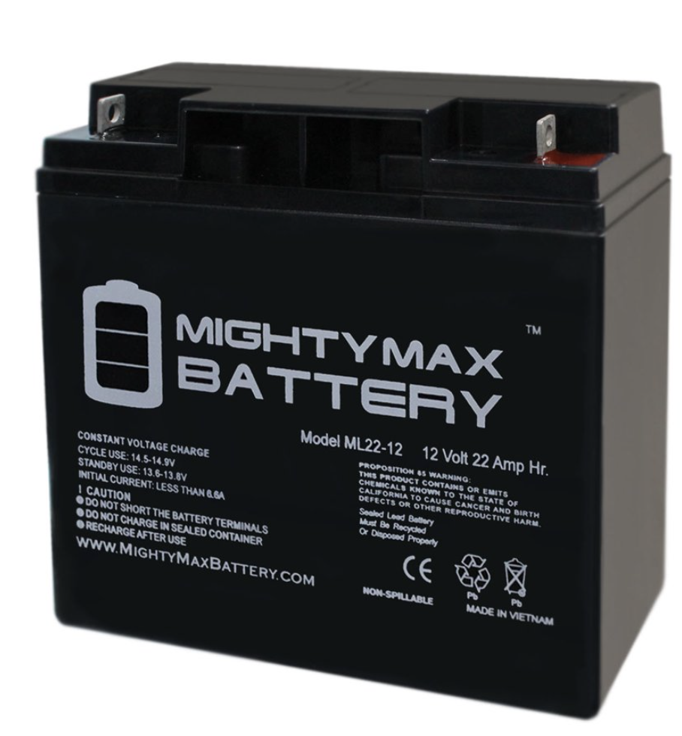
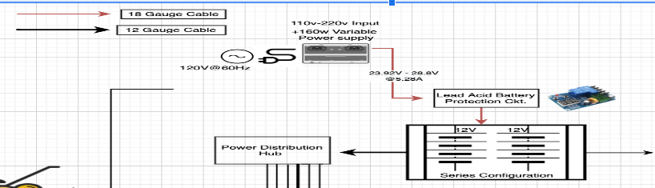
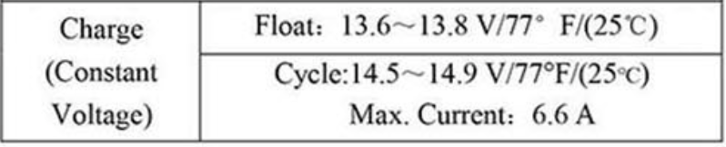
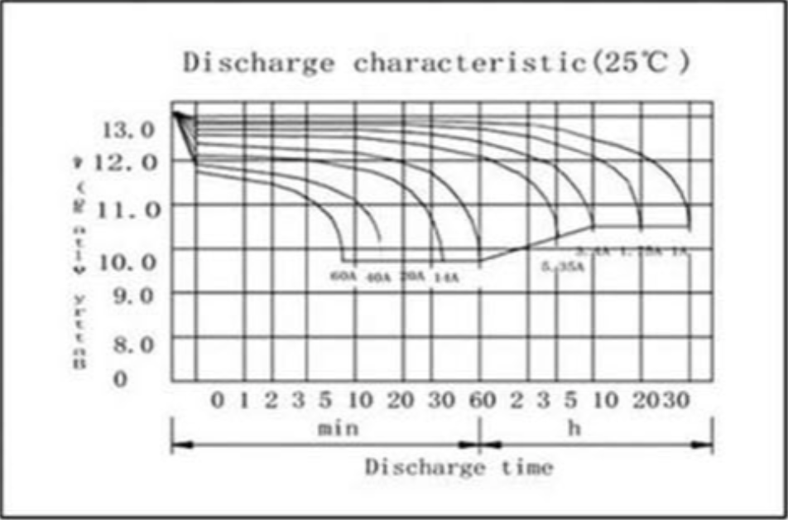
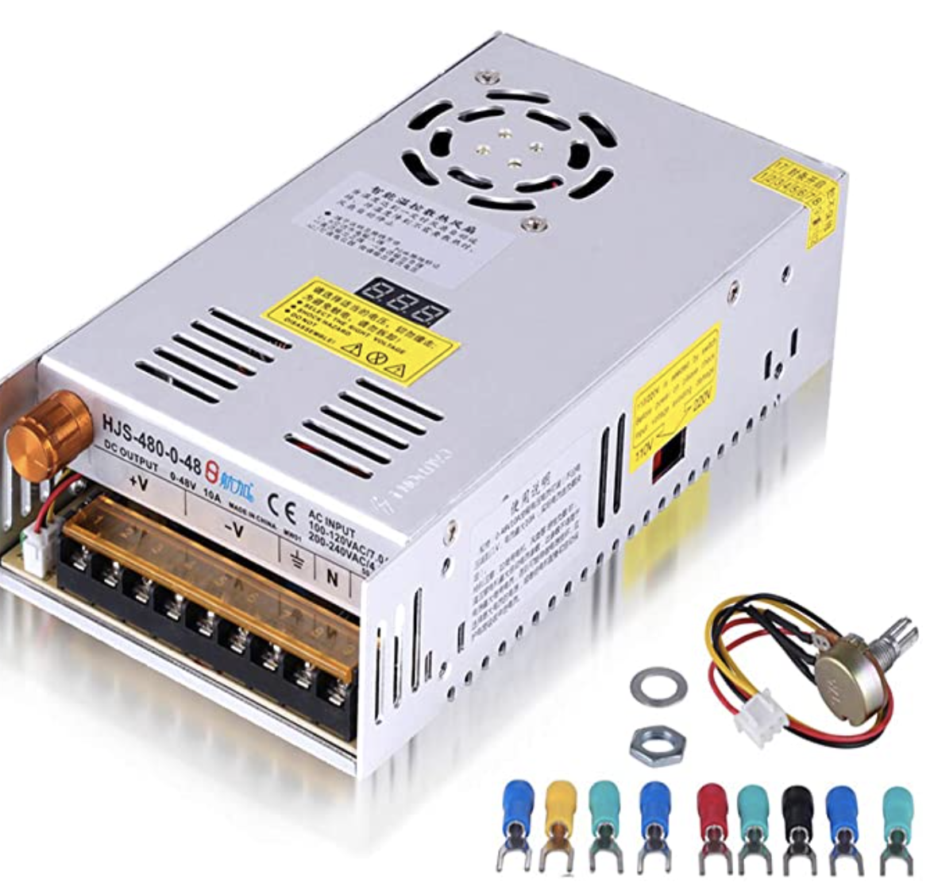
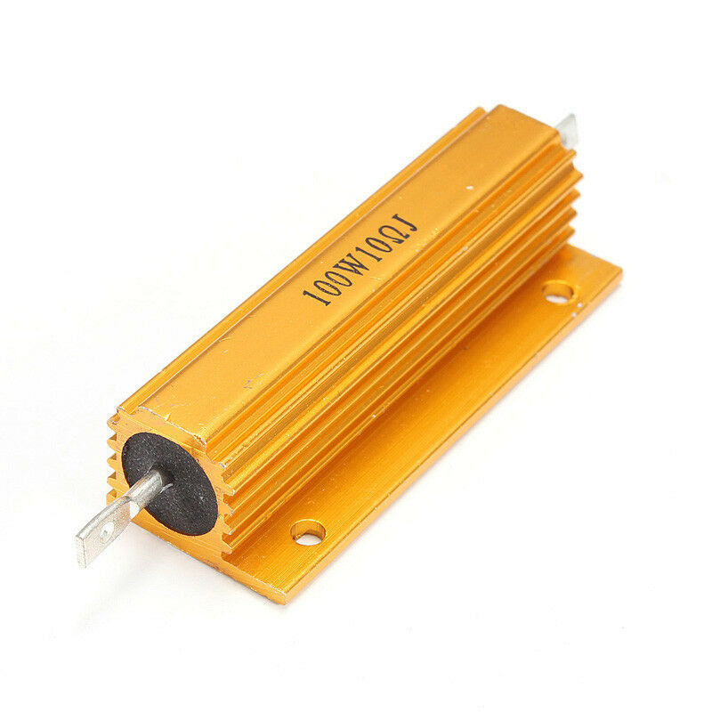
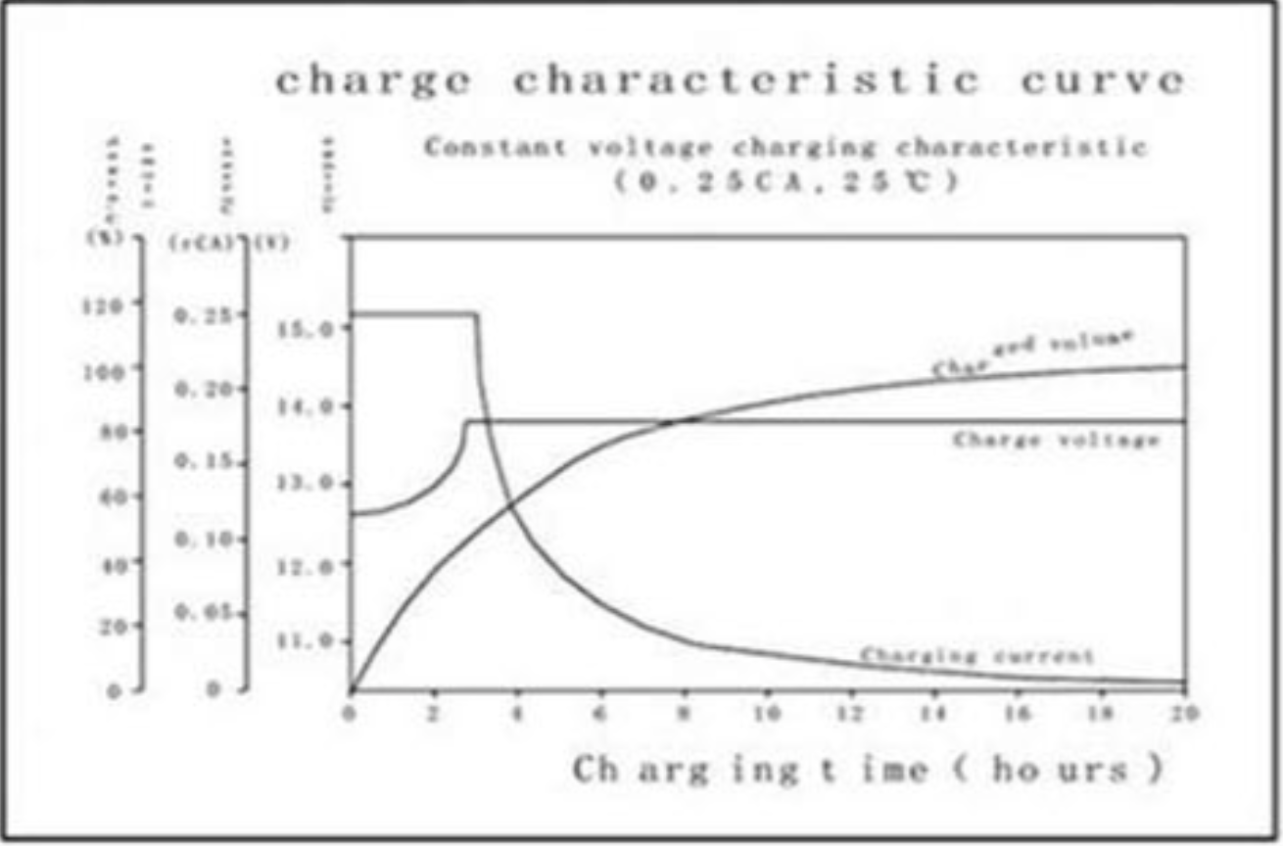
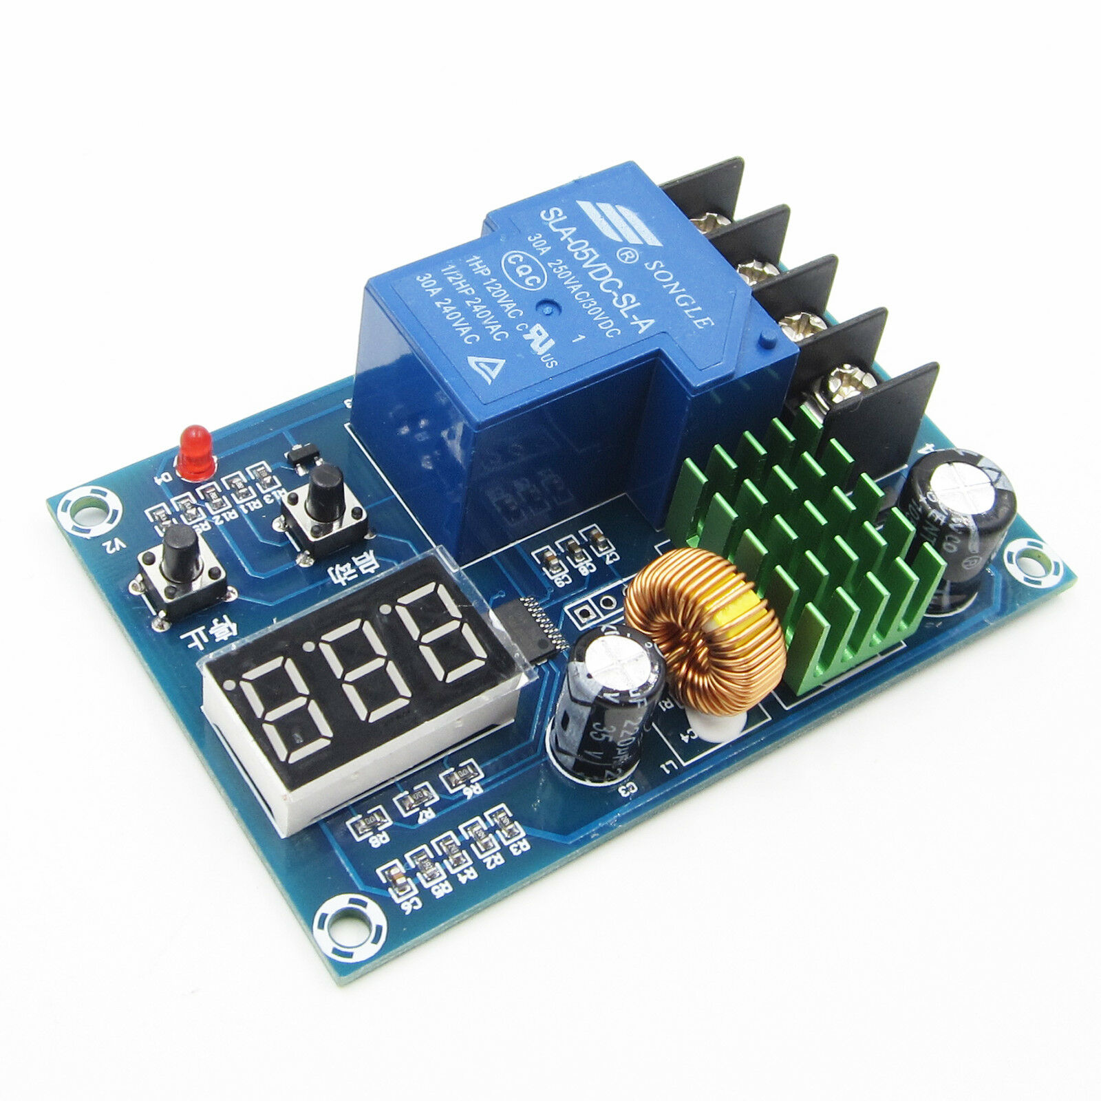
Battery Charger
Power Supply
- Input voltage range; AC110-220V
- Adjustable output voltage range; DC 0-48V
- Output current 10A-max; Unregulated
L.A.B Charge Controller(CC) Ckt.
- Manually adjustable standby charge start/stop voltage
Battery
- 22Ah(x2)
- 29.9Vmax; Charging Voltage
- 6.6Amax; Constant Charge Current
5-Ohm 25w current limiting resistor
- current limiter to CC; 5.28A

Slide 10
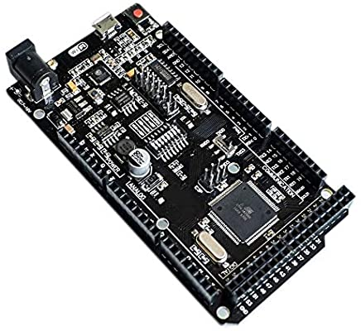
Arduino Mega2560 + WIFI
Total Price: $12
Quantity: 1
Description: The Arduino Mega2560 + WIFI is a microcontroller breakout broad with an ATmega2560 and ESP8266 combined into one. This MCU offers 32MB of memory as well as USB to serial TTL communication. This microcontroller will be the brains of the autonomous lawn mower

Slide 11
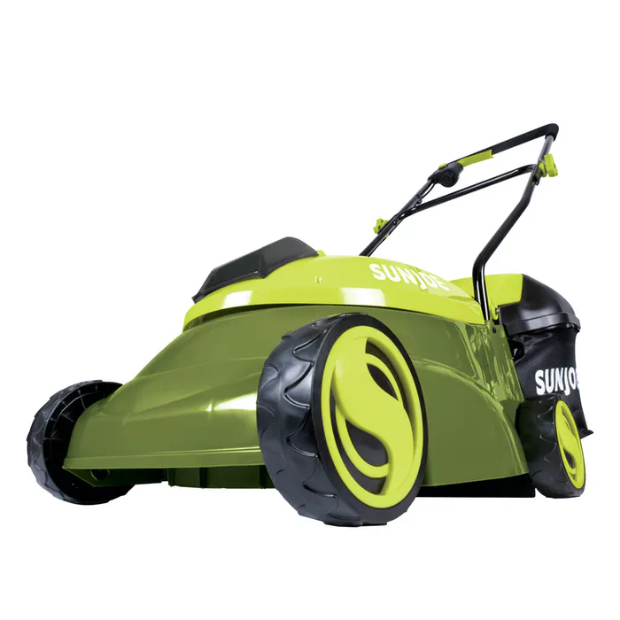
Sun Joe MJ401C Cordless Lawn Mower
Total Price: $82.50 [Got it for a black friday sale ;)]
Quantity: 1
Description: This 28 V, 4 Ah electric lawn mower has an operating time of 25 minutes. With the ability to cut a path of 14”, as well as the ability to push to start. This 23 pound lawnmower is perfectly lightweight for this project.

Slide 12
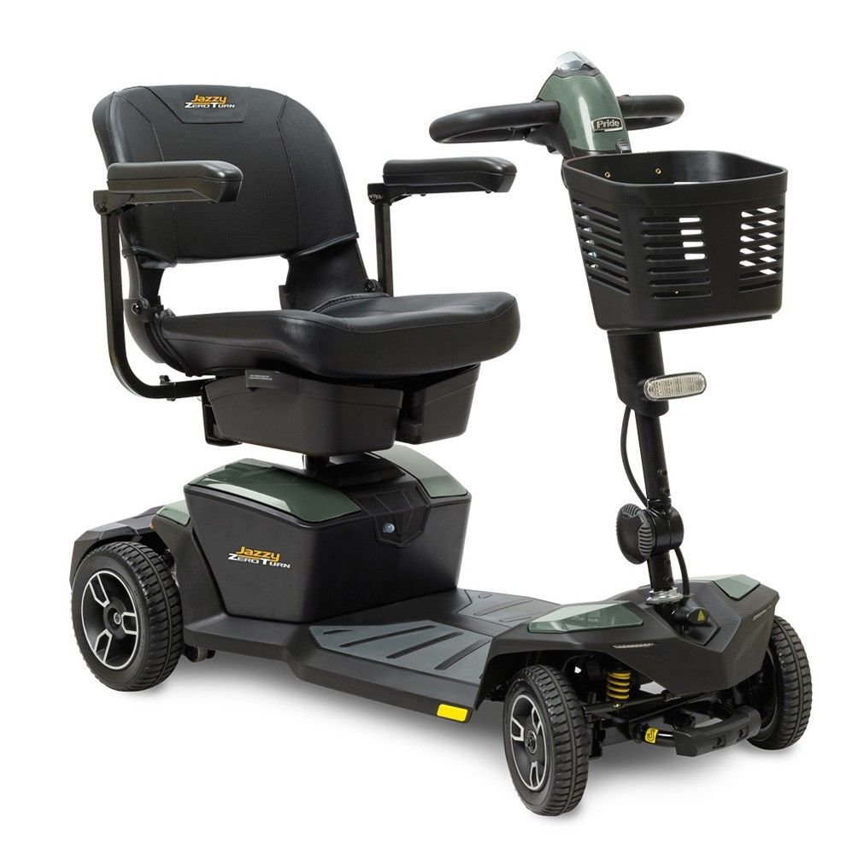
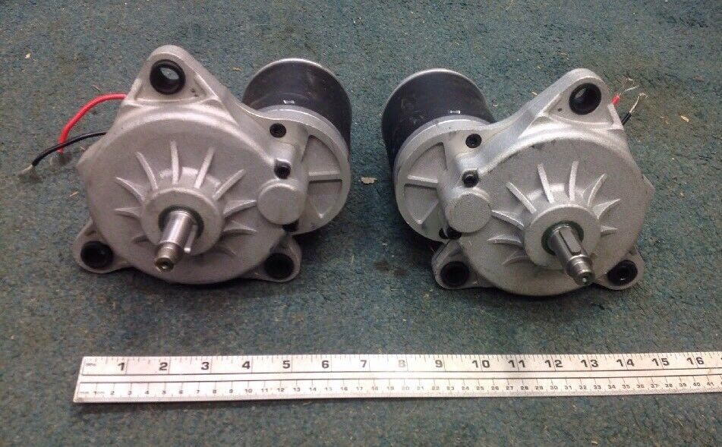
Jazzy Motors / Gearbox
Total Price: $55
Quantity: 2
Description: These Jazzy Motor / Gearbox are able to produce 120 RPM at 24 V DC or 60 RPM at 12 V DC. The motors have a 17mm straight shaft with keyway 31mm long(1.220").
Specs (requires verification via testing)
No-Load 3A
Load 25-40A
torque: ~50 ft lbs @ max draw

Slide 13
Sabertooth Dual Motor Driver
Total Price: $130.31
Quantity: 1
Description: The Sabertooth 2x32 is a dual channel motor driver which is capable of supplying 32 amps to two motors with peak currents of up to 64 amps per motor. This Motor Driver is able to work via radio control, analog, TTL serial or USB inputs

Slide 14
How to navigate in a lawn?
Step 1: Driving alone the perimeter of the mowing area with a remote controller.
Step 2: Record the Coordinate of the mowing area and obtain latitude and longitude from the GPS system.
Step 3: Store the X and Y coordinate into microcontroller.
Step 4: Set the mower at (0,0) coordinate and Start the mowing route
Step 5: Read route information from the microcontroller

Slide 15
NEO-6M GPS Module
Receivers Type: 50 Channels
Time-To-First-Fix: cold start 26 S, hot start 1 S
Sensitivity for Tracking:-162 dBm
Maximum Navigation Update rate 1 Hz
Horizontal Position Accuracy: 2.5 M
Price $9.35

Slide 16
SparkFun GPS-RTK Board-NEO-M8P-2
Receivers Type: 72 Channels
Time-To-First-Fix: cold start 26 S, hot start 1 S
Sensitivity for Tracking:-160 dBm
Maximum Navigation Update rate 5-8 Hz
Horizontal Position Accuracy: 2.5 CM
Price $224.95

Slide 17
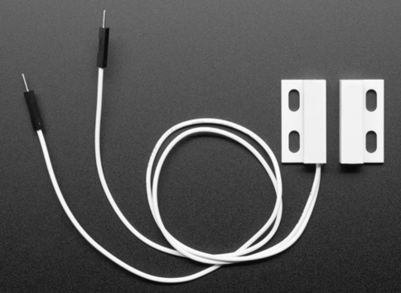
Magnetic Contact Switch
Normally open reed switch
ABS enclosure
Rated current: 100 mA max
Rated voltage: 200 VDC max
Distance: 15mm max
Price $5

Slide 18
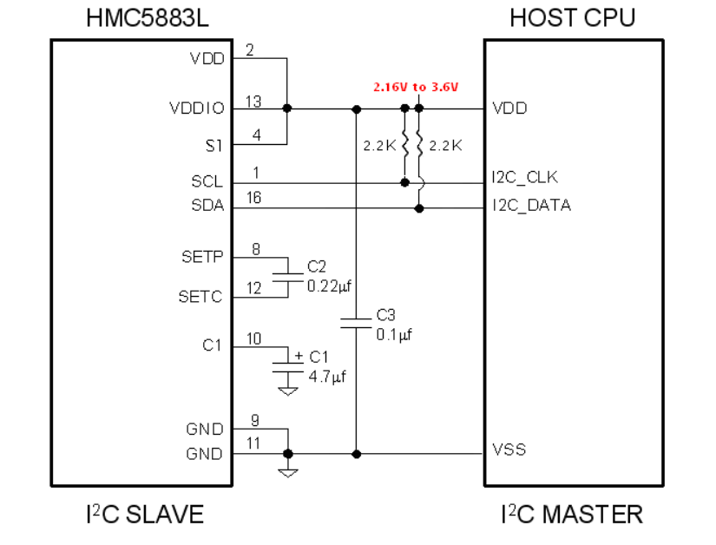
3-Axis Digital Compass IC HMC5883L
Supply Voltage: 2.16-3.6 V
Low Power Consumption:100 uA
12-Bit ADC
I^2C Ditital Interface
Maximum output Rate: 160 Hz
Compass Heading Accuracy: 1 to 2 Degree
Compatible for Battery Powered Application
Price $11.21

Slide 19
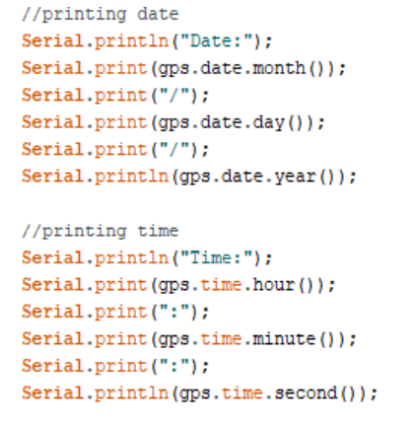
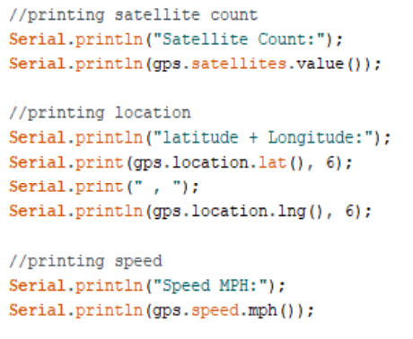
Neo-6M GPS Module Code

Slide 20
Digital Compass IC HMC5883L
#include <Arduino.h>
#include <Wire.h>
#include <HMC5883L_Simple.h>
// Create a compass
HMC5883L_Simple Compass;
void setup()
{
Serial.begin(9600);
Wire.begin();
Compass.SetDeclination(-0, 23, 'W’);
Compass.SetSamplingMode(COMPASS_SINGLE);
Compass.SetScale(COMPASS_SCALE_130);
Compass.SetOrientation(COMPASS_HORIZONTAL_X_NORTH);
}
// Our main program loop.
void loop()
{
float heading = Compass.GetHeadingDegrees();
Serial.print("Heading: \t");
Serial.println( heading );
delay(1000);
}

Slide 21
reference
https://www.reddit.com/r/mildlyinteresting/comments/6g2275/the_pattern_on_this_lawn_makes_it_look_3d/
https://www.brickhousesecurity.com/gps-trackers/gps-accuracy/
https://www.scag.com/pro-tip/lawn-striping-and-lawn-patterns/
https://www.lawnstarter.com/ny
http://ceng786-hw1-e162702.blogspot.com/2013/10/tangent-bug-planning-algorithm-with.html

